Slide 1

Computer Network Lab
Presented By: Md. Fahad bin Zamal

Slide 2
Router (Hardware)

Slide 3
Cisco IOS
Cisco technology is built around the Cisco Internetwork Operating System (IOS), which is the software that controls the routing and switching functions of internetworking devices.
A solid understanding of the IOS is essential for a network administrator.

Slide 4
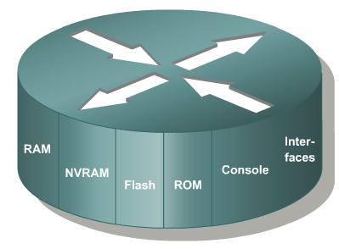
Introduction to Routers
A router is a special type of computer. It has the same basic components as a standard desktop PC. However, routers are designed to perform some very specific functions. Just as computers need operating systems to run software applications, routers need the Internetwork Operating System software (IOS) to run configuration files. These configuration files contain the instructions and parameters that control the flow of traffic in and out of the routers. The many parts of a router are shown below:

Slide 5
Router Memory Components
ROM - Read Only Memory – Bootstrap/POST
FLASH Memory- IOS Images are kept here
- Erasable reprogrammable ROM
- Contents are kept on Power down or reload
RAM - Random Access memory
- Routing Tables
- Running Configuration
- Contents are lost on reboot
NVRAM - Start up configuration
- Configuration Register
- Contents are kept on reload
Notes:
Function
POST
Bootstrap

Slide 6
ROM
Read-Only Memory
ROM has the following characteristics and functions:
Maintains instructions for power-on self test (POST) diagnostics
Stores bootstrap program and basic operating system software
Mini IOS
Notes:
Function
POST
Bootstrap

Slide 7
RAM
Random Access Memory, also called dynamic RAM (DRAM)
RAM has the following characteristics and functions:
Stores routing tables
Holds ARP cache
Performs packet buffering (shared RAM)
Provides temporary memory for the configuration file of the router while the router is powered on
Loses content when router is powered down or restarted

Slide 8
NVRAM
Non-Volatile RAM
NVRAM has the following characteristics and functions:
Provides storage for the startup configuration file
Retains content when router is powered down or restarted
Configuration Register – 16 bit register which decides boot sequence

Slide 9
Flash
Flash memory has the following characteristics and functions:
Holds the operating system image (IOS)
Allows software to be updated without removing and replacing chips on the processor
Retains content when router is powered down or restarted
Can store multiple versions of IOS software
Is a type of electronically erasable, programmable ROM (EEPROM)

Slide 10
Interfaces
Interfaces have the following characteristics and functions:
Connect router to network for frame entry and exit
Can be on the motherboard or on a separate module
Types of interfaces:
Ethernet
Fast Ethernet
Serial
ISDN BRI
Loopback
Console
Aux
Notes:
Enable router to connect other devices
Based on the type we have modular and non modular
Non modular are fixed
Modular can be added interfaces
Ethernet or FA – connecting to switch
Line – for the local configuration
Router – console port
PC- Serial Port
Aux – for remote configuration using a modem
BRI – for ISDN WAN connectivity
Ports are numbered serially

Slide 11
Router Power-On/Bootup Sequence:
Perform power-on self test (POST).
Load and run bootstrap code.
Find the Cisco IOS software.
Load the Cisco IOS software.
Find the configuration.
Load the configuration.
Run the configured Cisco IOS software.
Notes:
Emphasize: In a later slide, there is a very detailed flowchart of the router startup process.

Slide 12
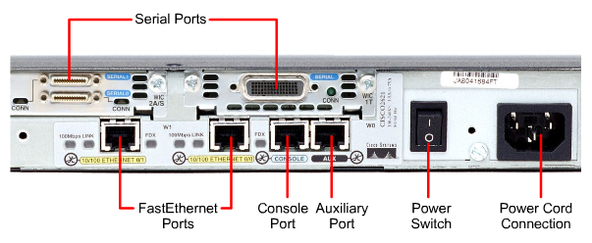
External Components of a 2600 Router

Slide 13
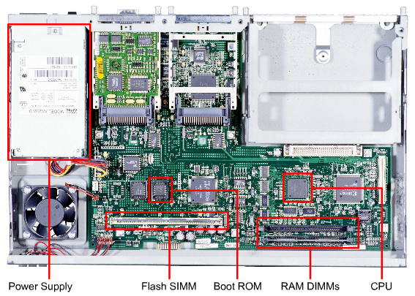
Internal Components of a 2600 Router

Slide 14
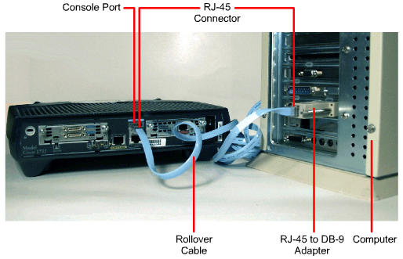
Computer/Terminal Console Connection

Slide 15
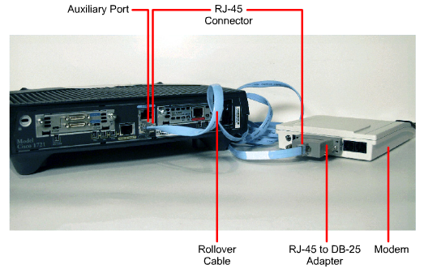
Modem Connection to Console/Aux Port

Slide 16
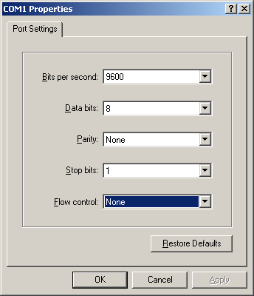
HyperTerminal Session Properties

Slide 17
Establishing a HyperTerminal Session:
Take the following steps to connect a terminal to the console port on the router:
First, connect the terminal using the RJ-45 to RJ-45 rollover cable and an RJ-45 to DB-9 or RJ-45 to DB-25 adapter.
Then, configure the terminal or PC terminal emulation software for 9600 baud, 8 data bits, no parity, 1 stop bit, and no flow control.

Slide 18
Router Configuration

Slide 19
Router User Interface Modes
The Cisco command-line interface (CLI) uses a hierarchical structure. This structure requires entry into different modes to accomplish particular tasks.
Each configuration mode is indicated with a distinctive prompt and allows only commands that are appropriate for that mode.
As a security feature the Cisco IOS software separates sessions into two access levels, user EXEC mode and privileged EXEC mode. The privileged EXEC mode is also known as enable mode.

Slide 20
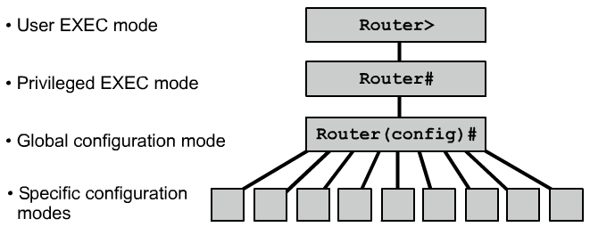
Overview of Router Modes

Slide 21
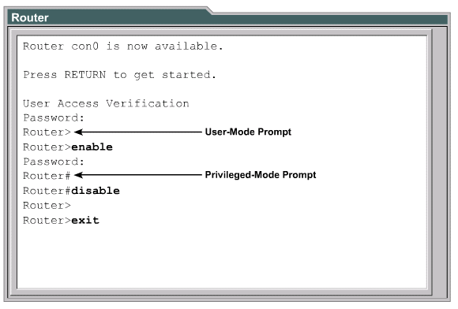
Router Modes

Slide 22
CLI Command Modes
All command-line interface (CLI) configuration changes to a Cisco router are made from the global configuration mode. Other more specific modes are entered depending upon the configuration change that is required.
Global configuration mode commands are used in a router to apply configuration statements that affect the system as a whole.
The following command moves the router into global configuration mode
Router#configure terminal (or config t) Router(config)#
When specific configuration modes are entered, the router prompt changes to indicate the current configuration mode.
Typing exit from one of these specific configuration modes will return the router to global configuration mode. Pressing Ctrl-Z returns the router to all the way back privileged EXEC mode.

Slide 23
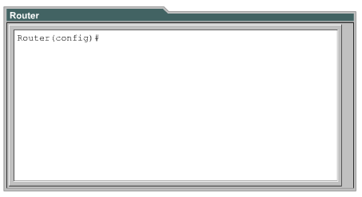
Router Command Line Interface:

Slide 24
LAB – Interface Configuration
R1
R2
30.0.0.2
R3
20.0.0.1
30.0.0.1
20.0.0.2
S0
10.0.0.1
S0
S0
S1
E0
E0
40.0.0.1
10.0.0.2
A
B
40.0.0.2
Notes:
The router Serial to serial
AUI to Host
Change Host name to R1 AND R2

Slide 25
Configuring Interfaces
An interface needs an IP Address and a Subnet Mask to be configured.
All interfaces are “shutdown” by default.
The DCE end of a serial interface needs a clock rate.
R1#config t R1(config)#int e0
R1(config)#Description Connoted to Host R1(config-if)#ip address 10.0.0.1 255.0.0.0
R1(config-if)#no shutdown
R1(config-if)#exit
R1(config)#interface serial 0
R1(config-if)#ip address 20.0.0.1 255.255.255.0
R1(config-if)# bandwidth 64
R1(config-if)#clock rate 64000 (required for serial DCE only) R1(config-if)#no shutdown
R1(config-if)#exit
R1(config)#exit
R1#
On new routers, Serial 1 would be just Serial 0/1 and e0 would be f0/0.
s = serial e = Ethernet f = fast Ethernet

Slide 26
Viewing Configuration:
To Check the status of interface
#Show IP interface brief
or
#Sh IP int brief
Notes:
To see the route
#Show IP route

Slide 27
Saving and Erasing Configurations:
To copy RAM to NVRAM
# copy run startup-config
To remove all configuration
# erase startup-config
# reload

Slide 28


Slide 29
Self Assessment…
Form the following diagram configures IP address for Corp, Router1 (R1), Router2 (R2), and Router3 (R3). Remember that, by default, these routers know only about networks that are directly connected to them.
The Corp router is a 2811 with four serial interfaces and a switch module, and routers 1 and 2 are 1841 routers. Router3 (R3) is another 2811 with a wireless interface card. The first step for this project is to correctly configure each router with an IP address on each interface. Table 1 shows the IP address scheme you are going to use to configure the network. Each network in the table has a 24-bit subnet mask (255.255.255.0).

Slide 30
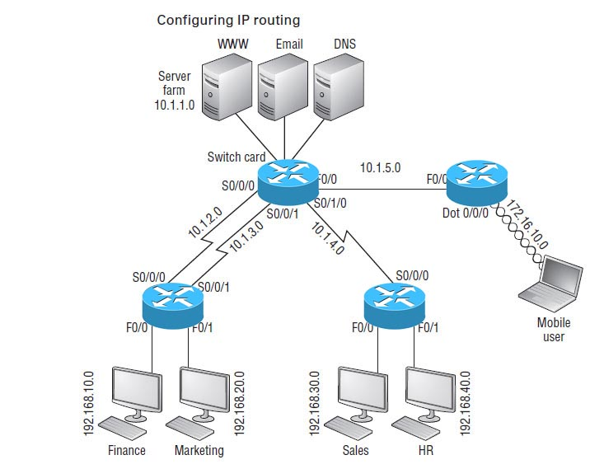
Self Assessment…

Slide 31
Self Assessment:
Router | Network Address | Interface | Address
CORP
Corp | 10.1.1.0 | Vlan1 (Switch Card) | 10.1.1.#
Corp | 10.1.2.0 | S0/0/0 | 10.1.2.#
Corp | 10.1.3.0 | S0/0/1 | 10.1.3.#
Corp | 10.1.4.0 | S0/1/0 | 10.1.4.#
Corp | 10.1.5.0 | f0/0 | 10.1.5.#
R1
R1 | 10.1.2.0 | S0/0/0 | 10.1.2.#(+1)
R1 | 10.1.3.0 | S0/0/1 | 10.1.3.# (+1)
R1 | 192.168.10.0 | f0/0 | 192.168.10.#
R1 | 192.168.20.0 | f0/1 | 192.168.20.#
R2
R2 | 10.1.4.0 | S0/0/0 | 10.1.4.#
R2 | 192.168.30.0 | f0/0 | 192.168.30.#
R2 | 192.168.40.0 | f0/1 | 192.168.40.#
R3
R3 | 10.1.5.0 | f0/0 | 10.1.5.#
R3 | 172.16.10.0 | Dot 1 Radio0/0/0 | 172.16.10.#

Slide 33


Slide 34
Routing

Slide 35
Routing:
The process of transferring data from one local area network to another
Layer 3 devices
Routed protocol Enables to forward packet from one router to another. Ex: IP, IPX
Routing protocol sends and receives routing information packets to and from other routers. Ex: RIP, OSPF , IGRP
Routing protocols gather and share the routing information used to maintain and update routing tables.
That routing information is in turn used to route a routed protocol to its final destination
Notes:
In internetworking, the process of moving a packet of data from source to destination. Routing is usually performed by a dedicated device called a router. Routing is a key feature of the Internet because it enables messages to pass from one computer to another and eventually reach the target machine. Each intermediary computer performs routing by passing along the message to the next computer. Part of this process involves analyzing a routing table to determine the best path. Routing is often confused with bridging, which performs a similar function. The principal difference between the two is that bridging occurs at a lower level and is therefore more of a hardware function whereas routing occurs at a higher level where the software component is more important. And because routing occurs at a higher level, it can perform more complex analysis to determine the optimal path for the packet.
A routing protocol sends and receives routing information packets to and from other routers. A routed protocol can be routed by a router, which means that it can be forwarded from one router to another. Yes, there are protocols that can't be routed, such as NetBEUI (Network Basic Input Output System Extended User Interface).
That a routed protocol can be routed may seem obvious, but unless you know how to differentiate it from a routing protocol, you may have trouble with the wording for some questions on the exam.
A protocol is a set of rules that defines how two devices communicate with one another. It also defines the format for the packets used to transmit data over communications lines. A routed protocol contains the data elements required for a packet to be sent outside its host network or network segment. In other words, a routed protocol can be routed. Protocols used to communicate routing information between routers within an autonomous system are Interior Gateway Protocols (IGP), which are routing protocols, but not routed protocols.
Routing protocols gather and share the routing information used to maintain and update routing tables. That routing information is in turn used to route a routed protocol to its final destination. Routing Information Protocol (RIP) and Interior Gateway Routing Protocol (IGRP) are the routing protocols you need to know for the exam. If you can remember what the abbreviations mean, you'll remember that they are routing protocols because they have routing in their names. Remember, too, that they are not routed protocols.
In short, routed protocols route your data and routing protocols send routing updates between routers about the status of the network so that your routed protocol data can be routed. Got that? No? Well, try this to help keep it straight:

Slide 36
Routing:
From
X
House #21, Road # 10
Chandigarh
To
Y
House #45, Road# 15
Mohali

Slide 37
What is Routing?
10.120.2.0
172.16.1.0
To route, a router needs to know:
Destination addresses
Sources it can learn from
Possible routes
Best route
Notes:
Purpose: This figure introduces students to routing. The router must accomplish the items listed in the figure for routing to occur.
Emphasize:
Path determination occurs at Layer 3, the network layer. The path determination function enables a router to evaluate the available paths to a destination and to establish the best path.
Routing services use network topology information when evaluating network paths. This information can be configured by the network administrator (static routes) or collected through dynamic processes (routing protocols) running in the network.
Transition:
How do you represent the path to the packet’s destination?

Slide 38
Route Types
Static routing - network administrator configures information about remote networks manually. They are used to reduce overhead and for security.
Dynamic routing - information is learned from other routers, and routing protocols adjust routes automatically.
Because of the extra administrative requirements, static routing does not have the scalability of dynamic routing.

Slide 39
Static Routes
Benefits
No overhead on the router CPU
No bandwidth usage between routers
Adds security
Disadvantage
Administrator must really understand the inter-network
If a network is added to the inter-network, the administrator has to add a route to it on all routers
Not feasible in large networks

Slide 40
LAB : Routing Implementation
R1
R2
30.0.0.2
R3
20.0.0.1
30.0.0.1
20.0.0.2
S0
10.0.0.1
S0
S0
S1
E0
E0
40.0.0.1
10.0.0.2
A
B
40.0.0.2
Host A can ping router R1 and R2
To enable Host A to Ping Host B we need to configure Routes
Notes:
The router Serial to serial
AUI to Host
Change Host name to R1 AND R2

Slide 41
Static Route Configuration
ip route [Destination network] [mask] [next-hop address or exit interface]
ip route The command used to create the static route.
Destination network The network you’re placing in the routing table.
mask The subnet mask being used on the network.
next-hop address The address of the next-hop router that will receive the packet and forward it to the remote network. This is a router interface that’s on a directly connected network.
Exit interface You can use it in place of the next-hop address if you want, but it’s got to be on a point-to-point link, such as a WAN
R1(config)#ip route 30.0.0.0 255.0.0.0 20.0.0.2
Notes:
Purpose: This figure describes the command syntax used to establish an IP static route.
Emphasize: A static route allows manual configuration of the routing table. No dynamic changes to this table entry will occur as long as the path is active. Routing updates are not sent on a link that is only defined by a static route; hence, conserving bandwidth.
Describe the The ip route field descriptions:
network—destination network or subnet
mask—subnet mask
address—IP address of next hop router
interface—name of interface to use to get to destination network.
Transition: The next figure provides a static route configuration example.

Slide 42
LAB :Static Route Configuration
R1
R2
30.0.0.2
R3
20.0.0.1
30.0.0.1
20.0.0.2
S0
10.0.0.1
S0
S0
S1
E0
E0
40.0.0.1
R2# config t
R2(config)#ip route 10.0.0.0 255.0.0.0 20.0.0.1
R2(config)#ip route 40.0.0.0 255.0.0.0 30.0.0.2
10.0.0.2
A
B
40.0.0.2
R1# config t
R1(config)#ip route 30.0.0.0 255.0.0.0 20.0.0.2
R1(config)#ip route 40.0.0.0 255.0.0.0 20.0.0.2
R3# config t
R3(config)#ip route 10.0.0.0 255.0.0.0 30.0.0.1
R3(config)#ip route 20.0.0.0 255.0.0.0 30.0.0.1
Notes:
The router Serial to serial
AUI to Host
Change Host name to R1 AND R2

Slide 43
Verifying Static Route Configuration
After static routes are configured it is important to verify that they are present in the routing table and that routing is working as expected.
The command show running-config is used to view the active configuration in RAM to verify that the static route was entered correctly.
The show ip route command is used to make sure that the static route is present in the routing table.

Slide 44
Default Routes
Can only use default routing on stub networks
Stub networks are those with only one exit path out of the network
The only routers that are considered to be in a stub network are R1 and R3
R1
20.0.0.1
R2
30.0.0.2
R3
30.0.0.1
10.0.0.1
S0
S1
40.0.0.1
E0
S0
S0
E0
20.0.0.2
10.0.0.2
A
B
40.0.0.2

Slide 45
Default Routes
Stub Network
172.16.1.0
Network
SO
10.0.0.0
A
B
172.16.2.2
B
172.16.2.1
ip route 0.0.0.0 0.0.0.0 172.16.2.2
This route allows the stub network to reach all known networks beyond router A.
Notes:
Purpose: This figure gives an example of a default route configuration.
Emphasize: With an address and subnet mask of 0.0.0.0 0.0.0.0 in the ip route statement, packets for any network not listed in the routing table will be sent to the next hop, 172.16.2.2.

Slide 46
Configuring Default Routes
Default routes are used to route packets with destinations that do not match any of the other routes in the routing table.
A default route is actually a special static route that uses this format:
ip route 0.0.0.0 0.0.0.0 [next-hop-address | outgoing interface]
This is sometimes referred to as a “Quad-Zero” route.
Example using next hop address:
Router(config)#ip route 0.0.0.0 0.0.0.0 172.16.4.1
Example using the exit interface:
Router(config)#ip route 0.0.0.0 0.0.0.0 s0/0

Slide 47
LAB Configuration
R1
R2
R3
20.0.0.1
30.0.0.1
30.0.0.2
S0
S1
10.0.0.1
E0
S0
40.0.0.1
S0
E0
20.0.0.2
A
B
40.0.0.2
10.0.0.2

Slide 48
Default Route LAB Configuration
R1
R2
R3
20.0.0.1
30.0.0.1
30.0.0.2
S0
S1
10.0.0.1
E0
S0
40.0.0.1
S0
E0
20.0.0.2
A
B
40.0.0.2
10.0.0.2
R2# config t
R2(config)#ip route 10.0.0.0 255.0.0.0 20.0.0.1
R2(config)#ip route 40.0.0.0 255.0.0.0 30.0.0.2
R1# config t
R1(config)#ip route 0.0.0.0 0.0.0.0 20.0.0.2
R3# config t
R3(config)#ip route 0.0.0.0 0.0.0.0 30.0.0.1
Notes:
The router Serial to serial
AUI to Host
Change Host name to R1 AND r2

Slide 49
Routing Information Protocol (RIP)
Routing Information Protocol (RIP) is a true distance-vector routing protocol.
It sends the complete routing table out to all active interfaces every 30 seconds
RIP only uses hop count to determine the best way to a remote network
It has a maximum allowable hop count of 15
AD is 120
Bellman-ford algorithm
Works well in small networks, but it’s inefficient on large networks
RIP version 1 uses only classfull routing, which means that all devices in the network must use the same subnet mask
RIP version 2 does send subnet mask information with the route updates. This is called classless routing.

Slide 50
Router Configuration
The router command starts a routing process.
The network command is required because it enables the routing process to determine which interfaces participate in the sending and receiving of routing updates.
An example of a routing configuration is:
Gates(config)#router rip
Gates(config-router)#network 172.16.0.0
The network numbers are based on the network class addresses, not subnet addresses or individual host addresses.

Slide 51
RIP Configuration
R1
R2
R3
192.168.20.1
192.168.30.1
S0
S0
S1
192.168.10.1
E0
S0
192.168.30.2
E0
192.168.40.1
192.168.20.2
R2# config t
R2(config)#router rip
R2(config)#network 192.168.20.0
R2(config)#network 192.168.30.0
A
B
192.168.40.2
192.168.10.2
R1# config t
R1(config)# )#router rip
R1(config)#network 192.168.10.0
R1(config)#network 192.168.20.0
R3# config t
R3(config)# )#router rip
R3(config)#network 192.168.30.0
R3(config)#network 192.168.40.0
Notes:
The router Serial to serial
AUI to Host
Change Host name to R1 AND r2

Slide 52
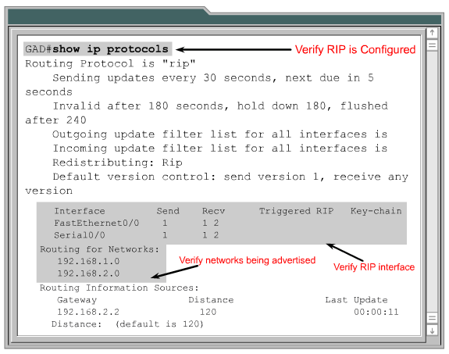
Verifying RIP Configuration

Slide 53
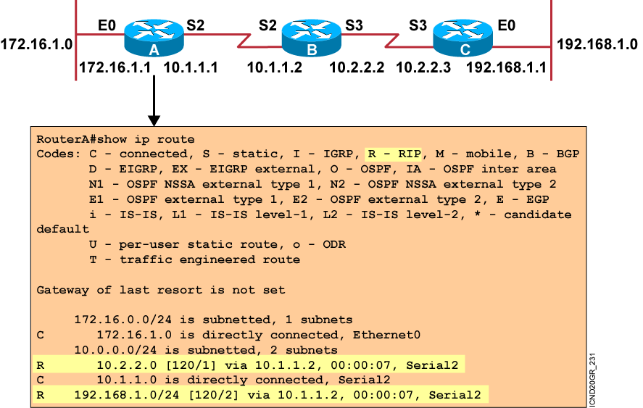
Displaying the IP Routing Table
Notes:
Purpose: This figure displays the show ip route command, which displays the contents of the router’s IP routing table.
Emphasize: Discuss the IP routing table in detail. Show the locations of the hop count (metric) and the administrative distance (120).
Discuss the following fields:
R—Refers to routes learned from RIP.
via—Refers to the router that informed us about this route.
00:00:07 timer value—RIP updates are every 30 seconds. Ask, “How long until the next update?”
The interfaces used for the best path

Slide 54
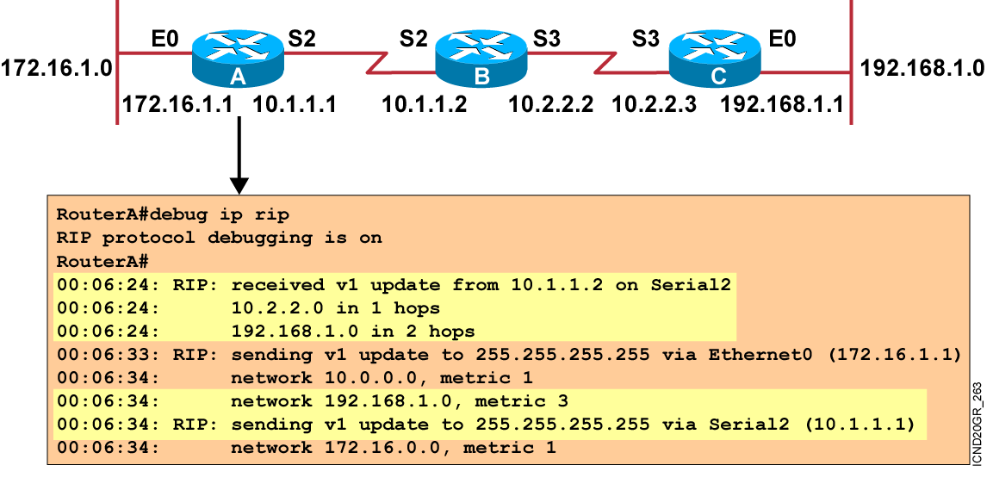
debug ip rip Command
Notes:
Purpose: This figure shows the debug ip rip command.
Emphasize: Explain that debug commands also provide information for monitoring IP.
The first highlighted line lists the source of the updates. The router returned information about two destinations.
The last highlighted line shows the broadcast address to which the router sent updates.

Slide 55
Passive Interface
Passive-interface command prevents RIP update broadcasts from being sent out a defined interface, but same interface can still receive RIP updates
R1#config t
R1(config)#router rip
R1(config-router)#network 192.168.10.0
R1(config-router)#passive-interface serial 0
Passive-interface command depends upon the routing protocol
RIP router with a passive interface will still learn about the networks advertised by other routers
EIGRP, a passive-interface will neither send nor receive updates.
Notes:
152-5

Slide 56
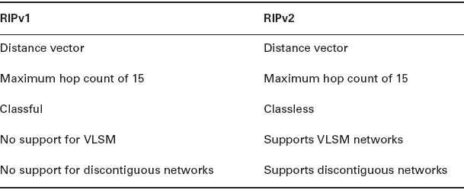
RIP Version 2 (RIPv2)
R1# config t
R1(config)# )#router rip
R1(config)#network 192.168.10.0
R1(config)#network 192.168.20.0
R1(config)#version 2

Slide 57
Exercise - RIP Version 2 Configuration
R1
R2
R3
192.168.0.4/30
192.168.0.8/30
S0
S0
S1
E0
S0
E0
192.168.0.16/29
192.168.0.32/28
A
B
1. Find out the IP Address and SNM of each interfaces

Slide 58
Exercise - RIP Version 2 Configuration
R1
R2
R3
192.168.0.5
255.255.255.252
192.168.0.9
255.255.255.252
S0
S0
S1
E0
S0
192.168.0.33
255.255.255.240
192.168.0.10
255.255.255.252
E0
192.168.0.17
255.255.255.248
192.168.0.6
255.255.255.252
A
B
192.168.0.34
255.255.255.240
192.168.0.18
255.255.255.248

Slide 59
Exercise - RIP Version 2 Configuration
R1
R2
R3
192.168.0.4/30
192.168.0.8/30
S0
S0
S1
E0
S0
E0
R2# config t
R2(config)#router rip
R2(config)#network 192.168.0.4
R2(config)#network 192.168.0.8
R2(config)#version 2
192.168.0.16/29
192.168.0.32/28
A
B
R1# config t
R1(config)# )#router rip
R1(config)#network 192.168.0.4
R1(config)#network 192.168.0.16
R1(config)#version 2
R3# config t
R3(config)# )#router rip
R3(config)#network 192.168.0.8
R3(config)#network 192.168.0.32
R3(config)#version 2

Slide 61
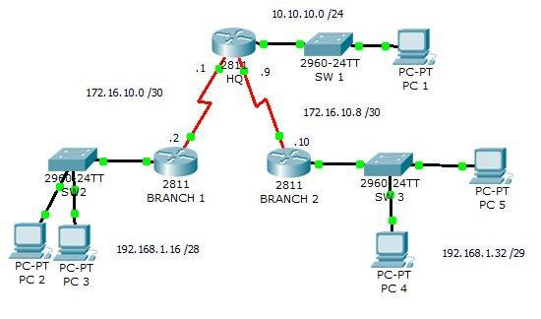
Self Assessment:

Slide 63
Thank You…

